Slide 1








Top Trumps
Kerry Crichton, Simran Kang & Amelia Bawden

Slide 2
Rules of the Game
⚡️Python generates a H.P character for player 1
⚡️ Player 1 chooses to bet on either their characters year of birth (yob), school house or ancestry
⚡️ Python generates a H.P character for player 2
⚡️ The winner is:
Most recent yob
Highest ranked house (as determined by python)
Highest ranked ancestry
⚡️ Best of 3 games wins
⚡️ In the event of a 3-way tie, the rankings of house and ancestry for each character for all 3 games are summed – highest ranked character wins

Slide 3
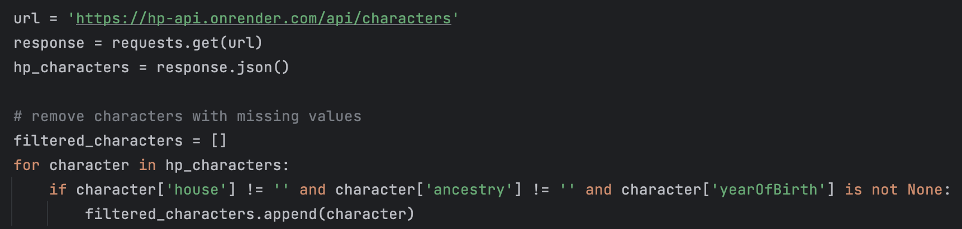
Trouble Shooting #1
⚡️Many missing values for many characters in the API
eg
⚡️ Solution:
Delete the dictionaries for characters where the values were missing for yob, school house and/or ancestry.
This step was done before player character selection.

Slide 4
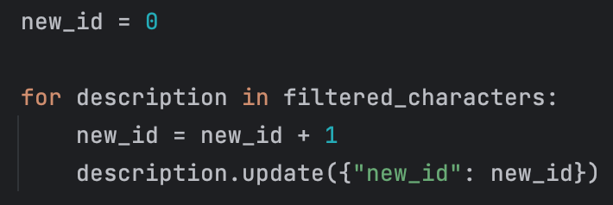
Trouble Shooting #2
⚡️Character ID in H.P API is in number-letter-symbol format
eg
⚡️ Solution:
Create a ‘new_id’ key with value ‘0’ and loop through each character, adding 1 onto the ‘new_id’ with every loop.
This allowed us to randomly assign a H.P character to each player via the pairing of ‘new_id’ and the number generated from the random module

Slide 5
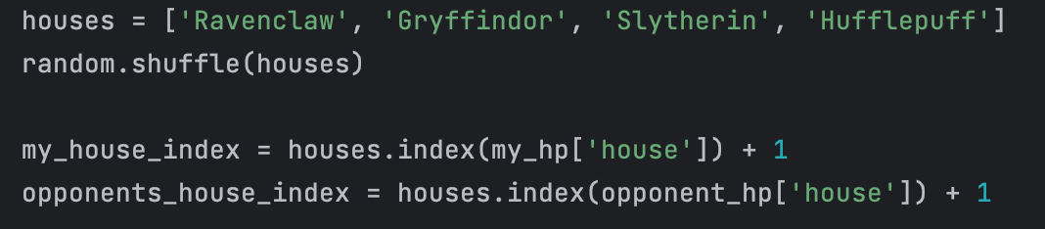
Trouble Shooting #3
⚡️No logical order to rank school house
⚡️ Solution:
Randomly shuffle the list of school houses and index each house with a number from 1 to 4. The house with the lowest index is the highest ranked.

Slide 6
Trouble Shooting #4
⚡️Deleting dictionaries with missing values left only 18 characters in total, all of whom were in either Gryffindor or Slytherin.
If all 3 games are played using school house, there is a high chance of a 3-way tie
⚡️ Solution:
For all 3 games, append the rankings of house and ancestry to a text file (one for each character). This is done even when house and ancestry are not bet on. In the event of a 3-way tie, the 6 x rankings are summed and the highest ranked (lowest number) character wins.

Slide 7
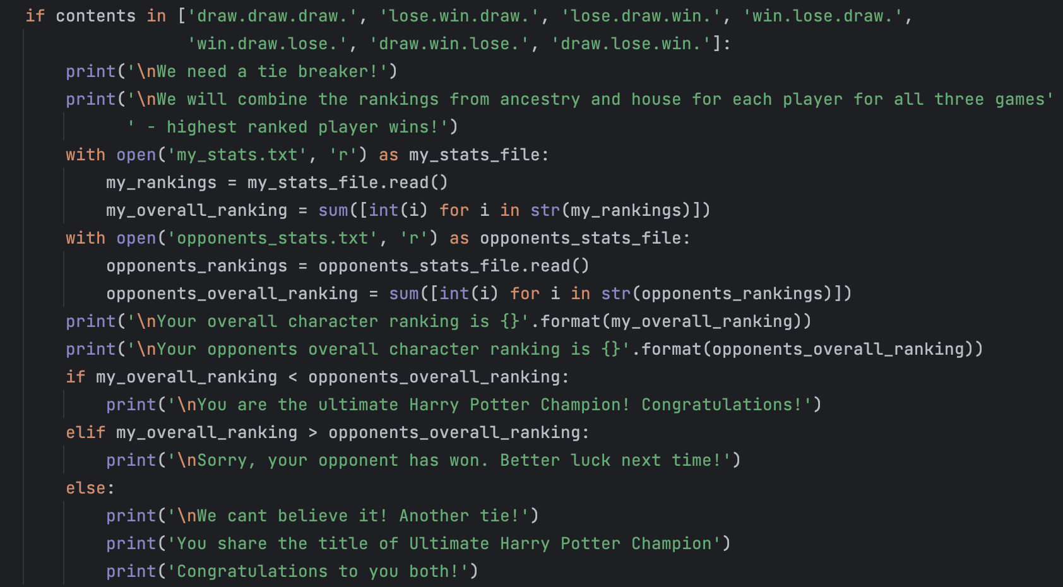
Trouble Shooting #4

Slide 8
Future Development
⚡️Three text files are created and read during the game
⚡️ Player 1 rankings for ancestry and school house
⚡️ Player 2 rankings for ancestry and school house
⚡️ Result after the 3 games e.g. win.lose.draw.
The code appends the results of each game to the end of the same line within the text files. Therefore, these 3 files must be deleted prior to starting another round of 3 games.
⚡️ Solution:
Learn how to append to a new line in a file after the nth character in the line has been reached.

Slide 9
Lets Play!

